Slide 1
Theory of probability

Slide 2

Definition of Probability
Let A be an event of Ω. Then the frequency ratio of A is
If the random experiment Ω is repeated a large number of times under identical or uniform conditions then the frequency ratio of A will be approximately equal to its probability, i.e.,
Thus, f(A) can be taken as to be an experimentally measured value of the idealised number P(A).
Longer is the sequence of repetitions of Ω more accurate is the measured value.
The definition of probability in terms of frequency interpretation restricts the class of random experiments, i.e., the random experiment must be repeated a large number of times in a uniform condition.

Slide 3


Example-1
What is the probability that a positive integer selected at random from the set of positive integers not exceeding 100 is divisible by (i) 5, (ii)5 or 3 (iii)5 and 3?
Solution: Ω = {1, 2, …, 100} so, n(Ω)= 100
Let A be an event that no. is divisible by 5, so A = {5,10,…,100}; so n(A)= 20. So,
Let B be an event that no. is divisible by 3, so B ={3,6,…,99}, so n(B)=33; so

Slide 4


Example-1
Let C be an event that no. is divisible by 5 or 3, C = A ∪ B, and n(A ∪ B)=47; so
Let D be an event that no. is divisible by 5 and 3, D = A ∩ B, and n(A ∩ B)=6; so

Slide 5

Deduction of some important rules
1. For any event A,
In the limit as , So,
2. For certain event S, , so in the limit P(S)=1
3. For impossible event O, n(O)=0. Hence, P(O)=0
4. For an event A, A+ A′=S (certain event)
So, P(A+ A′)=P(S) => P(A) + P(A′)=1
=> P(A)=1-P(A′)

Slide 6

Addition rule for pairwise mutually exclusive events
For two mutually exclusive events, A and B, n(A ∪ B) = n(A+B)= n(A) + n(B)
So, , therefore, in the limit P(A+B)=P(A)+P(B)
If A, B, C be pairwise mutually exclusive events, => , , and
Also => A and are mutually exclusive
so we have
In general, if be n pairwise mutually exclusive events then we have the following addition rule:

Slide 7


Conditional Probability
Let us consider two events A and B of Ω. Let us make the hypothesis that the event A has occurred.
Let n(A) times event A has occurred out of n(Ω).
Let, among these n(A) occurrence of A, the event B also occurs (along with A) times.
The ratio n(AB)/n(A) is called the conditional frequency ratio of B on the hypothesis that A has occurred and denoted by f(B/A), i.e., f(B/A)= n(AB)/n(A) =>
By Empirical or Statistical definition,
We assume that, this limit exist, this limit is called the conditional probability of B on the hypothesis that A has occurred.
So, as n(Ω) -> ∞, provided P(A) ≠ 0

Slide 8

Conditional Probability
Similarly, provided P(B) ≠ 0
Hence, if P(A), P(B) ≠ 0, we have
This is the Multiplication Rule
Addition rule:
Multiplication Rule:

Slide 9
General Addition Rule
General Addition Rule
Let us consider two events A and B of Ω. In general, they are not mutually exclusive.
But the events, A-AB, AB, and B-AB are always pairwise mutually exclusive.
So, A=(A-AB)+AB, B=(B-AB)+AB, and A+B=(A-AB)+AB+(B-AB)
By Addition rule for mutually exclusive events,
P(A)= P(A-AB)+P(AB), P(B)=P(B-AB)+P(AB), and
P(A+B)=P(A-AB)+P(AB)+P(B-AB)
= P(A)-P(AB)+P(AB)+P(B)-P(AB) = P(A)+P(B)-P(AB)
i.e., P(A+B)= P(A)+P(B)-P(AB)

Slide 10
General Addition Rule
For three events A, B, and C
P(A+B+C) = P(A+(B+C))=P(A)+P(B+C)-P(A(B+C))
= P(A)+P(B)+P(C)-P(BC)-P(AB+AC)
= P(A)+ P(B)+P(C)-P(BC)-[P(AB)+P(AC)-P(AB.AC)]
= P(A)+ P(B)+P(C)-P(BC)-P(AB)-P(AC)+P(AB.AC)
= P(A)+ P(B)+P(C)-P(AB)-P(BC)-P(CA)+P(ABC)
Generalising for n events, , we get

Slide 11
Examples
A coin is tossed 3 times in succession. Find the probability of (a) 2 heads (b) 2 consecutive heads

Slide 12
Examples
A coin is tossed 3 times in succession. Find the probability of (a) 2 heads (b) 2 consecutive heads
Sol: (a) Here,
Let, A is the event that 2 heads occur, then
So, P(A) = = 3/8
(b) Let B be the event that 2 consecutive heads occur, then n(B) = 3-1=2 [as head in first and third positions are not consecutive]
So, P(B)= = 2/8=1/4

Slide 13
Examples
2. Two dice are thrown. Find the probability that the sum of the faces equals or exceeds 10.

Slide 14
Examples
2. Two dice are thrown. Find the probability that the sum of the faces equals or exceeds 10.
Sol: Here,
Let, A, B, and C denote the events ‘Sum 10’, ‘Sum 11’, and ‘Sum 12’ respectively. So, A+B+C is the required event, where A, B, and C are pairwise mutually exclusive.
So, P(A+B+C) = P(A)+P(B)+P(C).
Now, P(A)= 3/36 as (4,6), (5,5), and (6,4) lie in A,
P(B)= 2/36 as (5,6) and (6,5) lie in B, and
P(C)= 1/36 as only (6,6) lies in C
So, P(A+B+C) = P(A)+P(B)+P(C)=3/36+2/36+1/36=6/36=1/6

Slide 15
Generalisation of Conditional Probability
Frequency ratio
For a long sequence of repetitions of the random experiment under uniform conditions, the conditional frequency ratio f(B/A) is taken to be an approximate value of the conditional probability P(B/A).
So, the conditional probability of B on the hypothesis that A has occurred is
Which gives the multiplication rule:
For three events A, B, C, we have

Slide 16
Generalisation of Conditional Probability
For three events A, B, C, we have
Proof: R.H.S=
In general, for n events the multiplication rule is:

Slide 17
Examples
A die is rolled. If the result is either an even face or a multiple of 3, then you win. What is the probability that multiple of 3 occurs on the hypothesis that even face occurs?

Slide 18
Examples
1. A die is rolled. If the result is either an even face or a multiple of 3, then you win. What is the probability that multiple of 3 occurs on the hypothesis that even face occurs?
Sol: Here,
Let, A and B denote the events ‘even face’, ‘multiple of 3, respectively. So, B/A is the required event.
So, P(B/A) = P(AB)/P(A).
Now, P(A)= 3/6 as (2), (4), and (6) lie in A,
P(B)= 2/6 as (3) and (6) lie in B
P(AB)= 1/6 as only (6) lies in AB
So, P(B/A) = P(AB)/P(A)=(1/6)/ (3/6)=1/3
Similarly, P(A/B)=P(AB)/P(B)=1/2

Slide 19
Examples
2. Two cards are drawn successively from a pack without replacing the first. If the first card is a spade, find the probability that the second card is also a spade.

Slide 20
Examples
2. Two cards are drawn successively from a pack without replacing the first. If the first card is a spade, find the probability that the second card is also a spade.
Sol1: Let A = first card is a spade, B=second card is a spade.
So, AB=both cards are spades.
= 52. 51, n(A)=13. 51, n(AB)=13.12
So, P(B/A)=P(AB)/P(A) = n(AB)/n(A)=(13.12) / (13.51) = 4/17
Sol2: When the first card is seen to be a spade, there are 51 cards remain in the pack out of which 12 are spade.
Hence, the probability that the second card is also a spade is 12/51=4/17

Slide 21
Bayes’ Theorem
Theorem: If be a given set of n pairwise mutually exclusive events, one of which certainly occurs, i.e.,
and
then for any arbitrary event X,
(i)
(ii) Bayes’ theorem: if P(X) ≠ 0,
Proof: For any event X, we have X=SX= =
Since,
Therefore, are pairwise mutually exclusive events, and
hence
[Addition Rule]
Since, [Multiplication Rule]
Therefore, [(i) is proved]

Slide 22
Bayes’ Theorem
We have already proved that
Now we have to prove the Bayes’ theorem: i.e., if P(X) ≠ 0,
Proof: [Multiplication Rule]
Also, [Multiplication Rule]
Hence, if P(X) ≠ 0,
Thus the Bayes’ theorem is proved.

Slide 23
Example on Bayes’ Theorem
Example-1: There are three identical urns containing white and black balls. The
first urn contains 2 white and 3 black balls, the second urn 3 white and 5 black
balls, and the third urn 5 white and 2 black balls. An urn is chosen at random,
and a ball is drawn from it. If the ball drawn is white, what is the probability
that the second urn is chosen?
Solution:
Let A= the event that the ball is drawn from the first urn, B= the event that the ball is drawn from the second urn, and C= the event that the ball is drawn from the third urn.
The events A, B, and C are pairwise mutually exclusive, and one of these necessarily occurs.
P(A) is the probability that 1st urn is chosen, and so on. So, P(A)=P(B)=P(C)=1/3
Let X=the event that ball drawn is white. So, P(X/A)=2/5, P(X/B)=3/8, P(X/C)=5/7.
We have to compute P(B/X)

Slide 24
Example-1 Cont… Compute P(B/X)
P(X)=P(A)P(X/A) + P(B)P(X/B)+P(C)P(X/C)
=(1/3)(2/5)+ (1/3)(3/8)+ (1/3)(5/7)
=(1/3)[2/5+3/8+5/7]
=(1/3)(417/280) = 139/280
So, By Bayes’ theorem:
P(B/X) = [P(X/B) P(B)]/ P(X)
= [(3/8)(1/3)] / (139/280)
=35/139 (Ans.)

Slide 25
Bayesian Classifier

Slide 26
Bayesian Classification: Why?
A statistical classifier: performs probabilistic prediction, i.e., predicts class membership probabilities
Foundation: Based on Bayes’ Theorem.
Performance: A simple Bayesian classifier, naïve Bayesian classifier, has comparable performance with decision tree and selected neural network classifiers

Slide 27
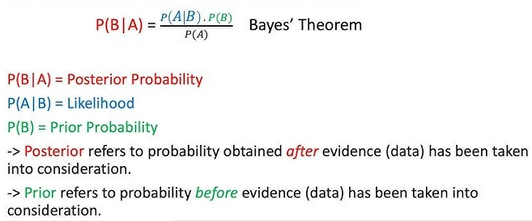
Bayesian Classification

Slide 28
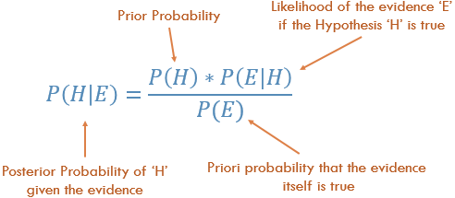
Bayesian Classification

Slide 29
Bayes’ Theorem: Basics
Bayes’ Theorem:
Let X be a data sample: class label is unknown
Let H be a hypothesis that X belongs to class C
Classification is to determine P(H|X), (i.e., posteriori probability): the probability that the hypothesis holds given the observed data sample X
P(H) (prior probability): the initial probability
E.g., X will buy computer, regardless of age, income, student, credit_rating.
P(X): probability that sample data is observed
P(X|H) : the probability of observing the sample X, given that the hypothesis holds
E.g., Given that X will buy computer, the prob. that X is 31..40, medium income

Slide 30
Prediction Based on Bayes’ Theorem
Given training data X, posteriori probability of a hypothesis H, P(H|X), follows the Bayes’ theorem
Predicts X belongs to C_{i} iff the probability P(C_{i}|X) is the highest among all the P(C_{k}|X) for all the k classes
Practical difficulty: It requires initial knowledge of many probabilities, involving significant computational cost

Slide 31
Classification Is to Derive the Maximum Posteriori
Let D be a training set of tuples and their associated class labels, and each tuple is represented by an n-D attribute vector X = (x₁, x₂, …, x_{n})
Suppose there are m classes C₁, C₂, …, C_{m}.
Classification is to derive the maximum posteriori, i.e., the maximal P(C_{i}|X)
This can be derived from Bayes’ theorem
Since P(X) is constant for all classes, so only
needs to be maximized

Slide 32
Naïve Bayes Classifier
A simplified assumption: attributes are conditionally independent (i.e., no dependence relation between attributes):
This greatly reduces the computation cost: Only counts the class distribution
If A_{k} is categorical, P(x_{k}|C_{i}) is the # of tuples in C_{i} having value x_{k} for A_{k} divided by |C_{i, D}| (# of tuples of C_{i} in D)
If A_{k} is continous-valued, P(x_{k}|C_{i}) is usually computed
based on Gaussian distribution with a mean μ and standard deviation σ , where
and P(x_{k}|C_{i}) =

Slide 33
Naïve Bayes Classifier: Training Dataset
Class:
C1:buys_computer = ‘yes’
C2:buys_computer = ‘no’
Data to be classified:
X = (age <=30,
Income = medium,
Student = yes
Credit_rating = Fair)

Slide 34
An Example
P(C_{i}): P(buys_computer = “yes”) = 9/14 = 0.643
P(buys_computer = “no”) = 5/14= 0.357
Compute P(X|C_{i}) for each class
P(age = “<=30” | buys_computer = “yes”) = 2/9 = 0.222
P(age = “<= 30” | buys_computer = “no”) = 3/5 = 0.6
P(income = “medium” | buys_computer = “yes”) = 4/9 = 0.444
P(income = “medium” | buys_computer = “no”) = 2/5 = 0.4
P(student = “yes” | buys_computer = “yes) = 6/9 = 0.667
P(student = “yes” | buys_computer = “no”) = 1/5 = 0.2
P(credit_rating = “fair” | buys_computer = “yes”) = 6/9 = 0.667
P(credit_rating = “fair” | buys_computer = “no”) = 2/5 = 0.4
X = (age <= 30 , income = medium, student = yes, credit_rating = fair)
P(X|C_{i}) : P(X|buys_computer = “yes”) = 0.222 x 0.444 x 0.667 x 0.667 =
0.044
P(X|buys_computer = “no”) = 0.6 x 0.4 x 0.2 x 0.4 = 0.019
P(X|C_{i})*P(C_{i}) : P(X|buys_computer = “yes”) * P(buys_computer = “yes”) =
0.044 x 0.643 = 0.028
P(X|buys_computer = “no”) * P(buys_computer = “no”) =
0.019 x 0.357 = 0.007
Therefore, X belongs to class (“buys_computer = yes”)

Slide 35
Avoiding the Zero-Probability Problem
Naïve Bayesian prediction requires each conditional prob. be non-zero. Otherwise, the predicted prob. will be zero
Ex. Suppose a dataset with 1000 tuples, income=low (0), income= medium (990), and income = high (10)
Use Laplacian correction (or Laplacian estimator)
Adding 1 to each case
Prob(income = low) = 1/1003
Prob(income = medium) = 991/1003
Prob(income = high) = 11/1003
The “corrected” prob. estimates are close to their “uncorrected” counterparts

Slide 36
Naïve Bayes Classifier: Comments
Advantages
Easy to implement
Good results obtained in most of the cases
Disadvantages
Assumption: class conditional independence, therefore loss of accuracy
Practically, dependencies exist among variables
E.g., hospitals: patients=> Profile: age, family history, etc.
Symptoms: fever, cough etc., Disease: lung cancer, diabetes, etc.
Dependencies among these cannot be modeled by Naïve Bayes Classifier
How to deal with these dependencies? Bayesian Belief Networks

Slide 37
kNN Algorithm

Slide 38
kNN Classifier
k-nearest neighbours (kNN) algorithm as a type of supervised algorithm which can be used for both classification as well as regression predictive problems.
There are three categories of learning algorithms:
i) Lazy learning algorithm: kNN is a lazy learning algorithm because it does not have a specialized training phase or model and uses all the data for training while classification
ii) Non-parametric learning algorithm: kNN is also a non-parametric learning algorithm because it does not assume about the distribution of the underlying data (as opposed to other algorithms such as Gaussian Mixture Model (GMM), which assume a Gaussian distribution about the data
iii) Eager learning algorithm: Eager learners, when given a set of training tuples, will construct a generalization model before receiving new (e.g., test) tuples to classify.

Slide 39
kNN Classifier
The kNN algorithm begins with a training dataset made up of examples that are classified into several categories.
Assume that we have a test dataset containing unlabeled examples that otherwise have the same features as the training data.
For each example (i.e., record) in the test dataset, kNN identifies k examples in the training data that are the "nearest" in similarity, where k is an integer specified in advance.
The unlabeled test instance is assigned the class of the majority of the k nearest neighbors

Slide 40
KNN: Classification Approach
Locating the unlabeled instance’s nearest neighbors requires a distance function, or a formula that measures the similarity between two instances.
There are many different ways to calculate distance. Traditionally, the kNN algorithm uses Euclidean distance.
The K-NN algorithm works by finding the K nearest neighbors to a given data point based on a distance metric, such as Euclidean distance.
The class or value of the data point is then determined by the majority vote (for classification) or average (for regression) of the K neighbors.

Slide 41
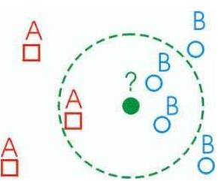
KNN: Classification Approach
Classified by “MAJORITY VOTES” for its neighbor
classes
🞑 Assigned to the most common class amongst its K- nearest neighbors

Slide 42
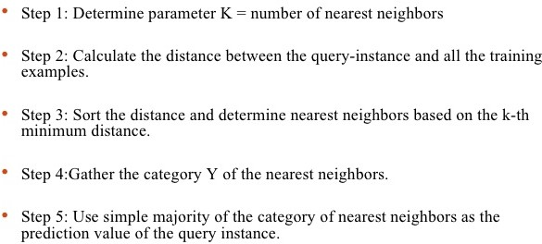
KNN: Pseudocode

Slide 43
Advantages of kNN
kNN algorithm is a versatile and widely used machine learning algorithm that is primarily used for its simplicity and ease of implementation.
It does not require any assumptions about the underlying data distribution.
It can also handle both numerical and categorical data, making it a flexible choice for various types of datasets in classification and regression tasks.
It is a non-parametric method that makes predictions based on the similarity of data points in a given dataset.

Slide 44
Advantages of kNN
K-NN is less sensitive to outliers compared to other algorithms.
Few Hyperparameters – The only parameters which are required in the training of a KNN algorithm are the value of k and the choice of the distance metric which we would like to choose from our evaluation metric.

Slide 45
Disadvantages of the KNN Algorithm
Does not scale – It is a lazy Algorithm. The main significance of this term is that this takes lots of computing power as well as data storage. This makes this algorithm both time-consuming and resource exhausting.
Curse of Dimensionality – The KNN algorithm is affected by the curse of dimensionality which implies the algorithm faces a hard time classifying the data points properly when the dimensionality is too high.
The curse of dimensionality can be particularly problematic in several ways:
(i) Distance Metrics Become Less Informative: In high-dimensional spaces, the concept of "distance" becomes less meaningful because the distances between all pairs of points tend to become more similar. This reduces the effectiveness of KNN, which relies on distance metrics to determine the nearest neighbors.
(ii) Sparsity of Data: As the number of dimensions increases, the volume of the space grows exponentially. This means that data points become sparse, making it harder for KNN to find enough neighbors that are truly representative of the underlying distribution of the data.

Slide 46
Disadvantages of the KNN Algorithm
(iii) Increased Computational Complexity: The computational cost of calculating distances between points increases with dimensionality. This can make KNN inefficient in practice when dealing with very high-dimensional data.
(iv) Overfitting: In high-dimensional spaces, KNN can become overly sensitive to noise in the data, leading to overfitting. This happens because with many dimensions, there’s a higher likelihood that some of the features will not be relevant, but they can still influence the nearest neighbor calculations.
To mitigate these issues, various techniques can be used:
(i) Dimensionality Reduction
(ii) Feature Selection
By addressing the curse of dimensionality through these methods, you can make KNN more effective even in high-dimensional settings.

Slide 47
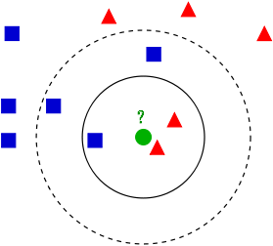
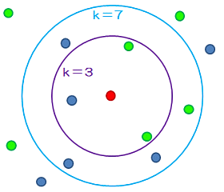
Variation In kNN

Slide 48
How to Choose the value of k?
The value of k is very crucial in the KNN algorithm to define the number of neighbors in the algorithm.
The value of k in the k-nearest neighbors (k-NN) algorithm should be chosen based on the input data. If the input data has more outliers or noise, a higher value of k would be better.
It is recommended to choose an odd value for k to avoid ties in classification.

Slide 49
Value of k
The small k value isn’t suitable for classification.
As a rule of thumb, setting k to the square root of the number of training samples can lead to better result. If k becomes 10 after the square root, we can choose either k=9 or k=11 just to make sure that k is odd.
Use an error plot or accuracy plot to find the most favorable k value.
kNN performs well with multi-label classes, but you must be aware of the outliers.

Slide 50
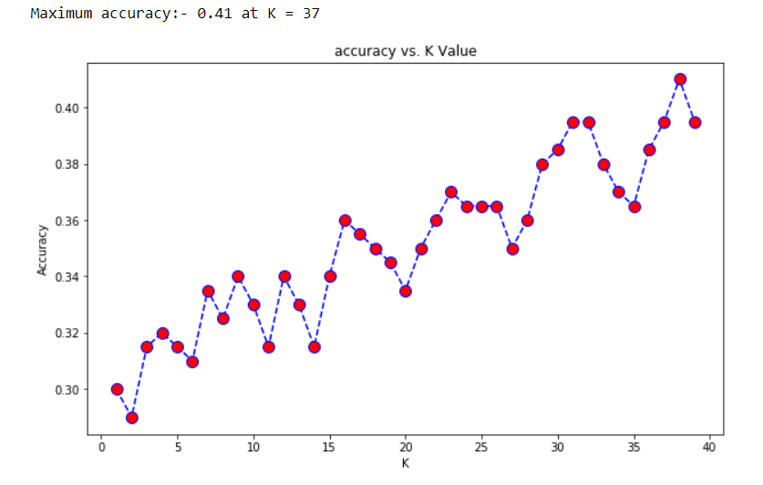
How to Choose the value of k?
We got the accuracy of 0.41 at K=37. As we got the minimum error at k=37, so we will get better efficiency at that K value.

Slide 51
Is Naïve Bayes a lazy learner?
The Naive Bayes algorithm is not a lazy learner. It is an eager learner. It is different from the nearest neighbor algorithm.
A real learning takes place for Naive Bayes. The parameters that are learned in Naive Bayes are the prior probabilities of different classes, as well as the likelihood of different features for each class.
In the test phase, these learned parameters are used to estimate the probability of each class for the given sample.
In other words, in Naive Bayes, for each sample in the test set, the parameters determined during training are used to estimate the probability of that sample belonging to different classes.

Slide 52
Is Naïve Bayes a lazy learner?
For example, P(c|x) ∝ P(c) P(x₁|c) P(x₂|c) ... p(x_{n}|c), where c is a class and x is a test sample.
All quantities P(c) and P(x_{i}|c) are parameters which are determined during training and are used during testing.
This is similar to NN, but the kind of learning and the kind of applying the learned model is different.

Slide 53
THANK YOU

